Slide 1
From the Essence of an Enterprise Towards
Enterprise SUPPORTING
INFORMATION SYSTEMS
Tanja Poletaeva
Tutors: Habib Abdulrab
Eduard Babkin
Notes:
Missed parts of the paper
Justification of the focus of the paper

Slide 2
Content
The scope and motivation of the research
Detailed cycles (to be) implemented in the scope of the Information Systems Research Framework

Slide 3

I. Scope – Collaborative Enterprise Network
Business interactions of autonomous social actors with …
… heterogeneous domains of knowledge;
Virtual collaborative assistants capable of
thorough information processing and “understanding” of a situation…
… for more productive interactions;
Virtual collaborative assistant consists of a piece of software that execute social acts, which are defined in the actor role of B-organization;
Notes:
No motivation on the slide !!

Slide 4
I. Definitions
Cognitive agent an enterprise information system able to interpret states in an enterprise world and to react to them in accordance with the fixed behavioral patterns and internal representations of the states to be reached.
Semantic metadata is based on the use of codified (implemented) ontologies as semantic domains for the definition of formal and real-world semantics of metadata schemes.
The metadata of a cognitive agent underlie its perceptual ability;
The semantic power of metadata defines agent’s interpretation ability;
Notes:
Metadata is semantic in two perspectives. Mathematical semantics…, Real-world semantics is …
In computer science, the notion of semantics is twofold.
In AI research, semantics is understood as a mapping (interpretation) from the language vocabulary to concepts that stand for entities in the real world.
In other works, the term (mathematical) “semantics” is used to denote rules for automated interpretation, which are not necessarily related to a real-world conceptualization [5].
In our work, both notions of semantics are used.

Slide 5
I. Motivation – Existent Solutions
Perspectives | Research
Ontology-based enterprise-specific data modeling | to be improved
Knowledge communication between intellectual agents | to be improved
Communication via uniform transactions | to re-use
The use of communication context when performing transactions / Conditions in action rules | to be improved
Run-time control if the instances of business transactions are compliant with the (DEMO) transactional patterns specification. | not considered
Notes:
We made an analysis of the existent works on different aspects of the information systems aimed at enterprise knowledge management.

Slide 6
II. Relevance Cycle (E → R) – Research Questions
Q1. How to define an enterprise modeling language with a formal semantics?
Q2. How cognitive agents operate enterprise knowledge? How to increase the interpretation ability of agents?
Q3. How can the communication context be effectively used in transactions of cognitive agents?
in assumption that social transactions in the B-organization are supported by PSI-based transactions of cognitive agents according to the PI-theory and DELTA-theory
Notes:
Following the Design Science research methodology, we consider three research cycles. The first one is the relenace cycle. Within this cycle we defined the following research questions…
Good design science research often begins by iden-tifying and representing opportunities and problems in an actual application environment.
However Iivari [Iivari 2007] points out that some design science research is about potentiality: the identification of new opportunities to im-prove practice before any problem is recognized.

Slide 7
II. Relevance Cycle (R → E) – Field Testing / Acceptance Criteria
There is a gap !
A simulation prototype was requested first when communicating with representatives of the Normandy port area

Slide 8
II. Rigor Cycle (KB → R) – Applied Scientific Foundations
1. A method to create languages that have enough expressivity for enterprise knowledge while preserving a formal semantics (Guizzardi [1])
(to respond Q1 - How to define an enterprise modeling language with a formal semantics?):
– the domain appropriateness and the comprehensibility appropriateness of an enterprise conceptual modeling language is guaranteed by the metamodel of this language representing full axiomatization of enterprise ontology.
– using a philosophically and cognitively well-founded formal ontology as a foundation for conceptual modeling languages can reinforce these languages.
2. The PSI-theory
3. The Unified Foundational Ontology (UFO)
[1] Guizzardi, G., Wagner, G. (2010) Using the Unified Foundational Ontology (UFO) as a Foundation for General Conceptual Modeling Languages

Slide 9
II. Rigor Cycle (KB → R) – Applied Scientific Foundations
4. The FI-theory, and
some reported methods of the factual knowledge processing;
– the summarized theory have to be discussed !
5. The PI-theory and DELTA-theory;
6. Ontology codification approaches (codification of powertypes, reified relations, time stamps);
7. The methods of action rules formalization and implementation;

Slide 10
II. Rigor Cycle (R → KB) – the Change of Scientific Foundations
1. The UFO ontology instead of the BORO foundational ontology;
2. The methods of action rules formalization and implementation;
3. The methods to reason facts, to compare facts, to understand facts, to integrate facts;

Slide 11
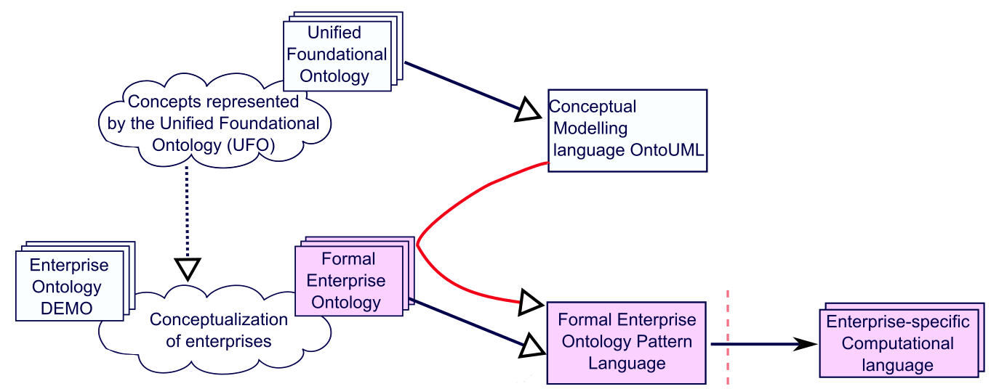
II. Design Cycle (A1) – The Formal Enterprise Ontology (FEO), and the Formal Enterprise Ontology Pattern Language (FEO-PL)

Slide 12
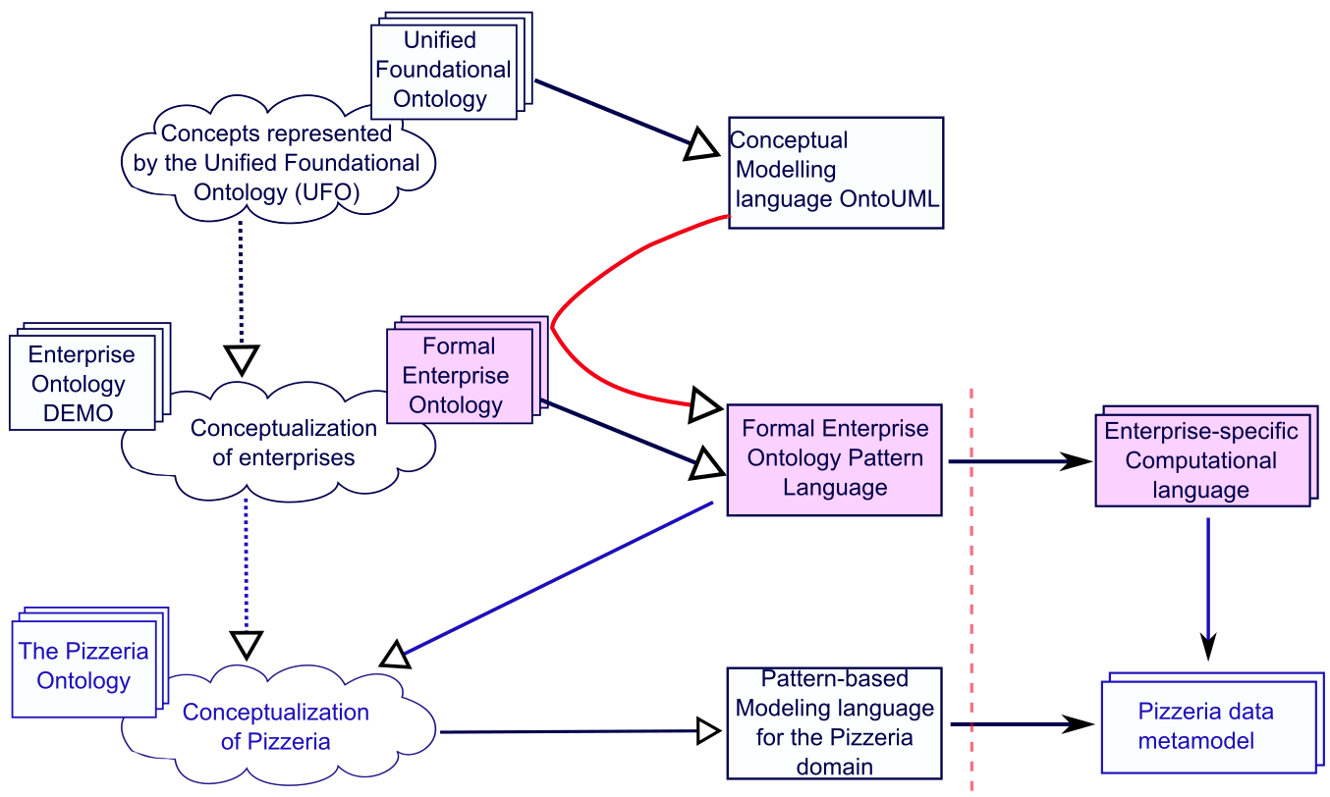
II. Design Cycle (A1) – The Formal Enterprise Ontology (FEO), and the Formal Enterprise Ontology Pattern Language (FEO-PL)

Slide 13
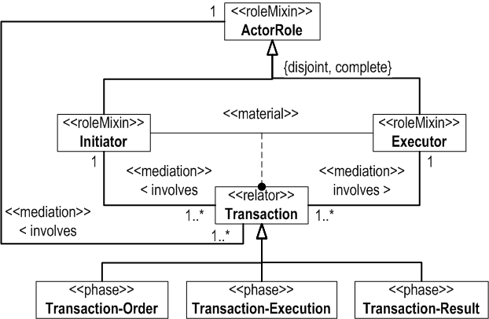
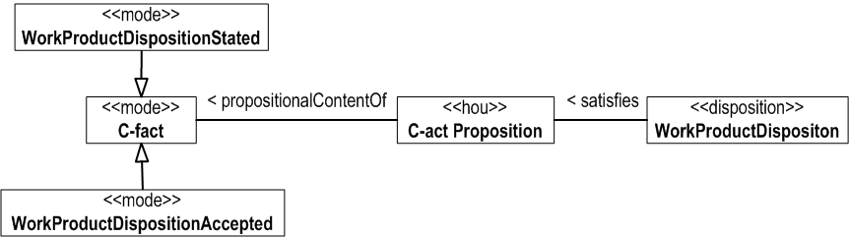
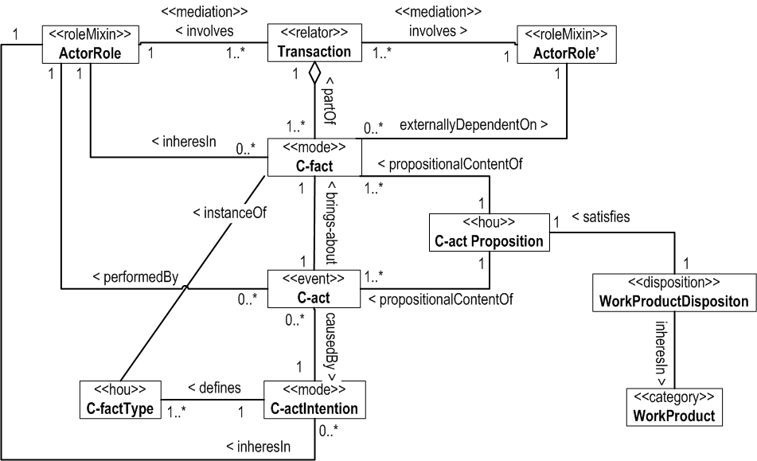
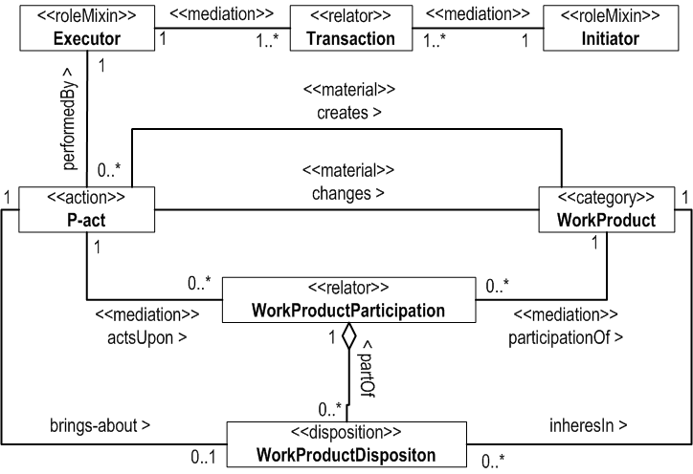
II. Design Cycle (A1) – Formal Enterprise Ontology Pattern Language (FEO-PL)
Verification of the logical consistency of FEO-PL metamodel by means of embedded OLED tools

Slide 14
II. Design Cycle (A2) – the method of codification of the FEO-based models
OntoUML Light-weight EDitor (OLED) [1] © NEMO/UFES is designed to support conceptual modeling in OntoUML including codification of models in OWL/SWRL;
The method of a conceptual model codification have to correlate with the reasoning methods;
Codification methods of the OLED editor should be extended in order to be applicable to FEO-based models;
– Since OLED is improved continuously, it may be found after discussions with the experts that the work is partially done;
[1] OntoUML Lightweight Editor: https://github.com/nemo-ufes/ontouml-lightweight-editor

Slide 15
II. Design Cycle (A3) – the method of action rules specification and implementation in accordance with the FEO-PL
1. The use of factual knowledge to formally specify transition rules of cognitive agents:
Type 1 of transition rules: A set of transition rules is a total function TR: (CF, S)→ (CA, I, P) that maps each C-factum of CF appeared in a particular state S to C-acts from CA with the related instances of intention from I and proposition from P.
2. The specification of transition rules according to the proposed Formal Enterprise Ontology Patterns;
3. The implementation method of transition rules should be developed;
NOTE: this step is hardly dependent on the chosen definition of ‘Facts’.
Notes:
Let CF be the union of the extensions of the C-fact type of which instances an actor role is prescribed to deal with, and S be the union of all possible facts (including instances of C-and P-fact types) that an actor may need to know for reacting C-facts. Let I be the set of intentions that may be evoked in the actor, let P be the set of propositions which intentions are about, and CA be the union of all possible C-acts with the specified intention and proposition.

Slide 16
Design Cycle (A4) – the methods to operate with factual knowledge & the implemented functionality
Cognitive agents should be able
to reason facts;
to compare facts (and to resolve contradictions);
to understand facts (to discover the meaning on references or from boundary objects);
to integrate facts;
The scope of the task:
the amount of methods and problems of automated ontologies mapping, integration, and reasoning;
Notes:
- The methods of ontology mapping & integration;

Slide 17
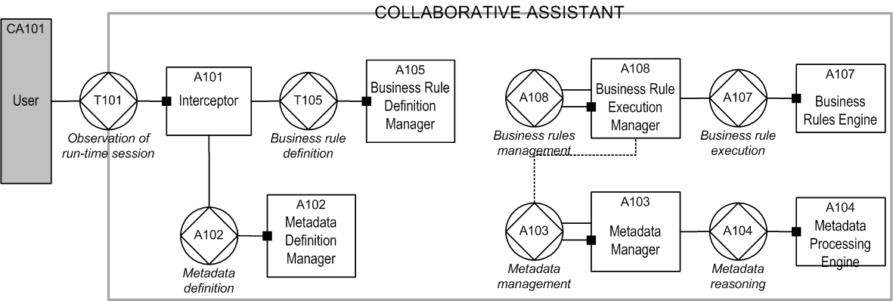
Design Cycle (A5) – specification of the constructional perspectives of collaborative assistants

Slide 18
Future Steps
…very ambitious.
Discussion and thorough verification of FEO-PL with the experts;
Improvement of the codification method after discussions with the experts and a validation by the application in use-cases;
The method of action rules specification and implementation in accordance with the FEO-PL;
The methods to operate with factual knowledge & the implemented functionality of cognitive agents;
Specification of the constructional perspectives of collaborative assistants;

Slide 19

THANK YOU FOR YOUR ATTENTION !
AND FOR YOUR QUESTIONS

